Slide 1

Analyzing reasons of crash traffic in American roadways
Team 3
Members:
- Pham Minh Hieu(Leader)
- Vu Do Thanh Dat
- Pham Hai Nhi
- Nguyen Chi Hoang

Slide 2
Analyzing reasons of crash traffic in American roadways
Unit 1. Introduce
1.1. Background Information
1.2. Motivation & Objective
1.3. Members & Role Assignment
1.4. Schedule & Milestones
Unit 2. Project Execution
2.1. Simulated Scenario Description
2.2. Datasets Selection and Description
2.3. Data Ingestion Pipeline
2.4. Data Transformation Processing
2.5. Data Query & Insight
Unit 3. Results
3.1. Data Ingestion Scripts & Code
3.2. Data Transformation Scripts & Code
3.3. Description and Sample of Transformed Datasets
3.4. Data Visualization of Query Results
3.5. AI & ML
Unit 4. Impact of the project
4.1. Accomplishment & Benefit
4.2. Future improvement
Unit 5. Team Member Review and Comment

Slide 3

UNIT
01
Unit 1. Introduce

Slide 4
1.1. Background Information
Unit 1. Introduce
UNIT
01
Background: Road safety is crucial in the U.S. because traffic crashes cause thousands of deaths and injuries every year. Improving safety on our roads can save lives, reduce healthcare costs, and prevent damage to infrastructure. With more vehicles and complex traffic systems, focusing on road safety is essential for protecting communities.
1.2. Motivation & Objectives
Motivation: Reducing traffic accidents is a critical issue in the United States, causing significant human and economic losses each year. This project aims to identify the main causes of traffic accidents through data analysis, allowing us to propose effective preventive measures that can save lives and minimize social and economic impacts.
Objective: Our project aims to identify and analyze the root causes of traffic crashes in the U.S. This will help develop strategies to reduce accidents and improve road safety.

Slide 5
1.3. Members & Role Assignments
Unit 1. Introduce
UNIT
01
Pham Minh Hieu ( Leader ): Analyze data, Design demo, Test demo
Vu Do Thanh Dat: Design PowerPoint , Support analyze data
Pham Hai Nhi: Design report , support analyze data
Nguyen Chi Hoang: Find information , support design demo

Slide 6
1.4. Schedule & Milestones
Unit 1. Introduce
UNIT
01
Week 1: Data Collection and Planning
Tasks: Identify and acquire the relevant datasets from national traffic accident databases. Conduct an initial review of the data and set up the AWS environment. Develop a detailed project plan and assign tasks to team members.
Milestones: Dataset selection was completed, the AWS environment was set up, and the project plan was finalized.
Week 2: Data Ingestion and Transformation, Data Analysis, Visualization, and Reporting
Tasks: Begin the process of data ingestion by loading the data into Hadoop. Create databases in HIVE and start processing raw data. Ensure data is cleaned, transformed, and stored in a structured format ready for analysis. Perform detailed data analysis using SQL queries to identify trends and insights. Develop visualizations in Power BI to represent the findings clearly. Compile the final report and prepare for the presentation of the project results.
Milestones: The data ingestion pipeline is operational, and the initial data cleaning and transformation are completed. Key insights were identified, visualizations and dashboards were created, and the final report and presentation were completed.

Slide 7
UNIT
02
Unit 2. Project Execution

Slide 8
2.1. Simulated Scenario Description
Unit 2. Project Execution
UNIT
02
The project simulates analyzing traffic accidents across American roadways, involving processing a large dataset with details on accident locations, causes, timing, weather, and severity. The team acts as a data analysis unit, tasked with cleaning, processing, and analyzing the data to generate insights that can inform policy decisions, improve road safety, and reduce accident frequency and severity. The process mirrors real-world challenges faced by transportation authorities.

Slide 9
2.2. Datasets Selection and Description
Unit 2. Project Execution
UNIT
02
Dataset Overview: The primary dataset used in this project consists of traffic accident records across various American roadways over a defined period. This dataset is sourced from reputable national traffic safety databases and includes a comprehensive set of variables related to traffic accidents.
Key variables:
Accident Location
Date and Time
Weather Conditions
Road Conditions
Accident Cause
Relevance
Completeness
Accuracy
Volume

Slide 10
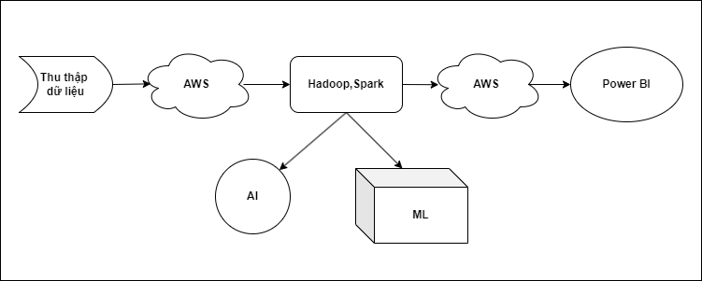
2.3. Project Pipeline
Unit 2. Project Execution
UNIT
02
Step 1: Data Upload to AWS
Step 2: Data processing in Hadoop
Step 3 : Visualation

Slide 11
2.4. Data Transformation Processing
Unit 2. Project Execution
UNIT
02
Once the raw data is ingested and stored, the next phase involves transforming the data into a format suitable for analysis. This stage includes data cleaning,
normalization, and transformation processes.
Data Cleaning
Handling Missing Data
Removing Outliers
Data Nomalization
Standardizing Data Formats
Scaling Numerical Data
Data Transformation
Feature Engineering
Aggregation

Slide 12
2.5. Data Query and Insight
Unit 2. Project Execution
UNIT
02
With the transformed data ready, the project moves into the querying phase, where we
extract key insights from the dataset.
SQL Querying
We write and execute complex SQL queries against the Hive database to explore the data. These queries are designed to uncover patterns related to accident locations, times,
and causes. For instance, queries might reveal which roads have the highest accident rates or which times of day see the most accidents.
Exploratory Data Analysis (EDA):
Using statistical tools, we conduct an exploratory data analysis identify correlations and trends within the data. EDA techniques such as correlation matrices, pivot tables,
and visualizations (like histograms and scatter plots) help us gain a deeper understanding of the dataset.
Insight Extraction
The final step in this phase is synthesizing the findings into actionable insights. We identify the most accident-prone roads and the primary causes of accidents, providing a clear picture of the traffic safety landscape on American roadways. These insights form the foundation for the recommendations and solutions proposed in later sections of the report.

Slide 13
UNIT
03
Unit 3. Results

Slide 14
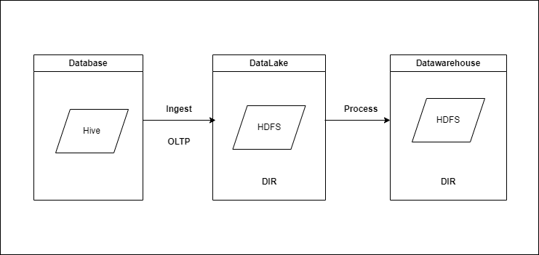
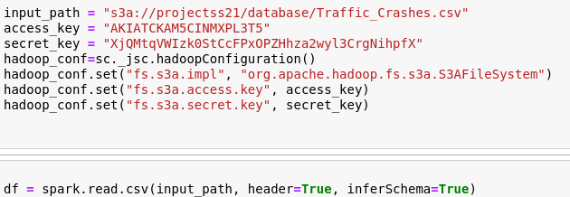
3.1. Data Ingestion Scrips and Code
Unit 3. Results
UNIT
03
AWS S3 Data Upload Script:
This script ensures that the data is securely stored in the cloud, making it accessible for the Hadoop processing pipeline

Slide 15
3.2. Data Transformation Scrips and Code
Unit 3. Results
UNIT
03
Data transformation is a key phase where raw data is cleaned, normalized, \and converted into formats suitable for analysis. This section outlines the scripts and code used for these transformations.

Slide 16
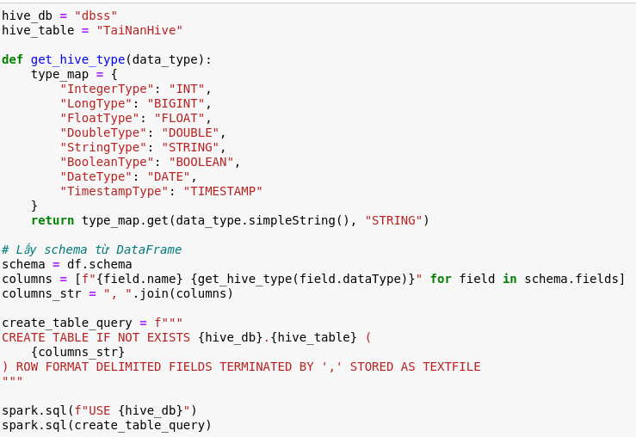

3.2. Data Transformation Scrips and Code
Unit 3. Results
UNIT
03
Hadoop Database Ingestion Code
When loading data in aws, the file is in .csv format, you need to convert this file into a table and save it to Hive, this is where the data is stored (Database).

Slide 17
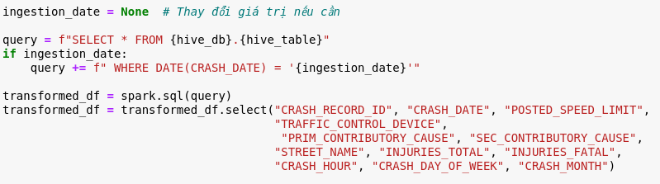
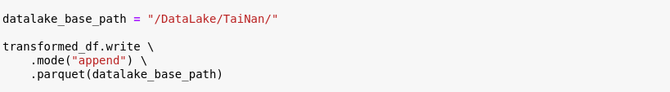
3.2. Data Transformation Scrips and Code
Unit 3. Results
UNIT
03
Database Ingest DataLake
Retrieve data from the Database and perform queries to get the data needed for the project. A new data table is created and saved to DataLake.

Slide 18
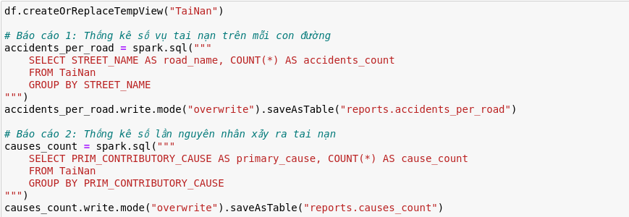
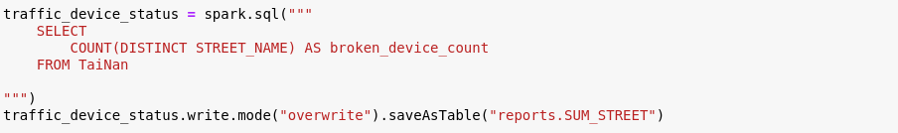
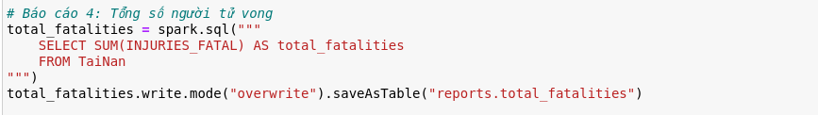
3.2. Data Transformation Scrips and Code
Unit 3. Results
UNIT
03
DataLake process DataWarehouse
Retrieve raw data from DataLake, conduct queries to create sub-tables containing data to create reports. These data tables are saved to Datawarehouse.
.

Slide 19
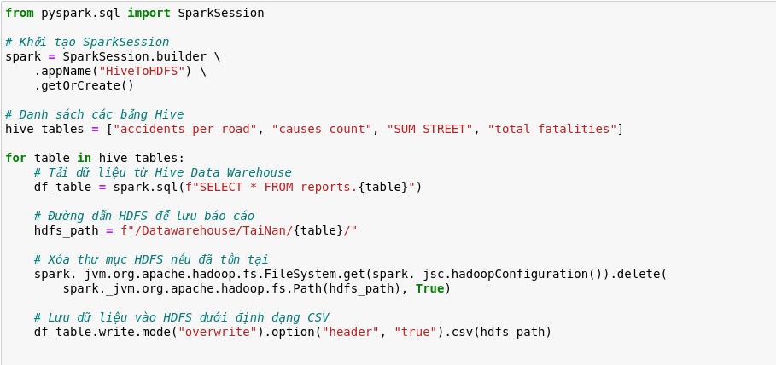
3.2. Data Transformation Scrips and Code
Unit 3. Results
UNIT
03
DataLake process DataWarehouse
Retrieve raw data from DataLake, conduct queries to create sub-tables containing data to create reports. These data tables are saved to Datawarehouse.
.

Slide 20
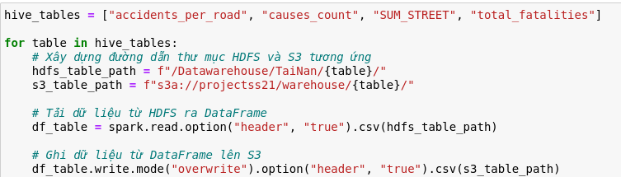
3.2. Data Transformation Scrips and Code
Unit 3. Results
UNIT
03
DataWarehouse to AWS
Data are tables saved in DataLake that are transferred and stored in AWS as .csv files. Data saved in aws will be convenient for visualization and data management.
.

Slide 21
3.3. Description and Sample of Transformed Datasets
Unit 3. Results
UNIT
03
The transformed datasets are integral to the analysis, as they represent the cleaned, structured, and feature-engineered data ready for insights extraction. Here, we
provide a detailed description of these datasets along with samples of the data.

Slide 22
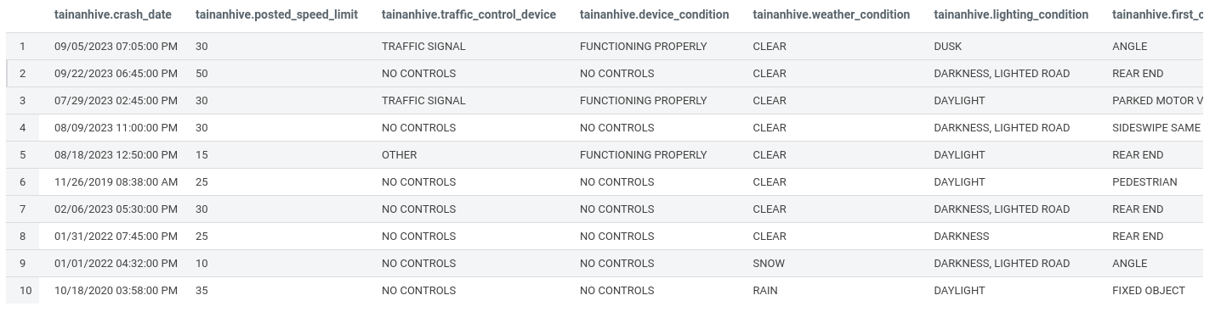
3.3. Description and Sample of Transformed Datasets
Unit 3. Results
UNIT
03
Database ingest DataLake

Slide 23
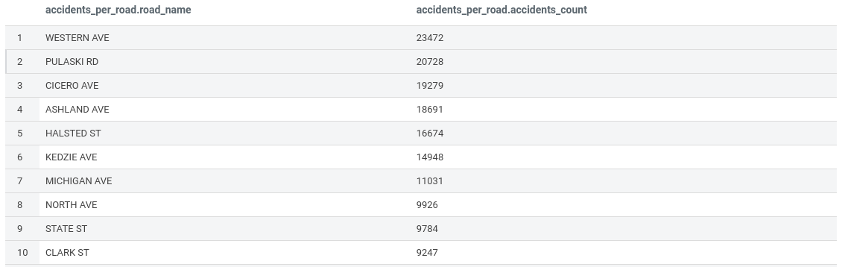
3.3. Description and Sample of Transformed Datasets
Unit 3. Results
UNIT
03
Datalake process DataWarehouse
Accident Frequency by Location

Slide 24
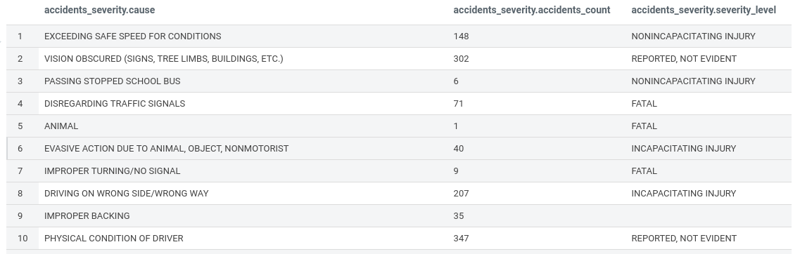
3.3. Description and Sample of Transformed Datasets
Unit 3. Results
UNIT
03
Datalake process DataWarehouse
Statistics on causes of accidents

Slide 25
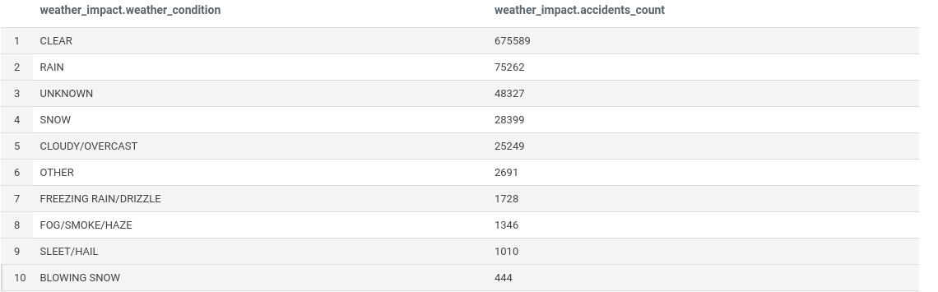
3.3. Description and Sample of Transformed Datasets
Unit 3. Results
UNIT
03
Datalake process DataWarehouse
Weather impact on Accidents

Slide 26
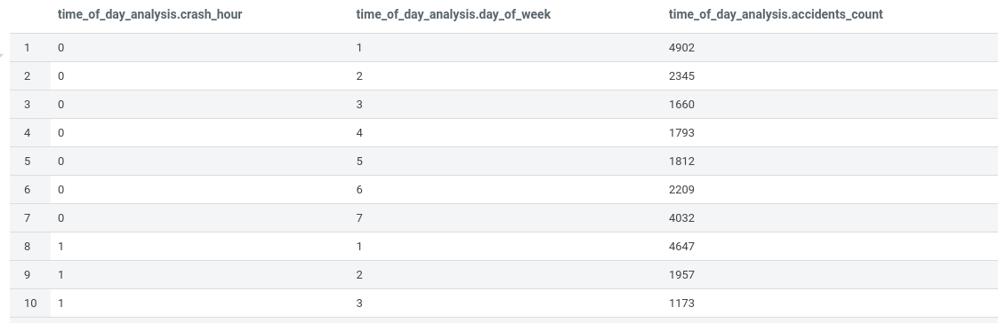
3.3. Description and Sample of Transformed Datasets
Unit 3. Results
UNIT
03
Datalake process DataWarehouse
Time-of-days analysis

Slide 27
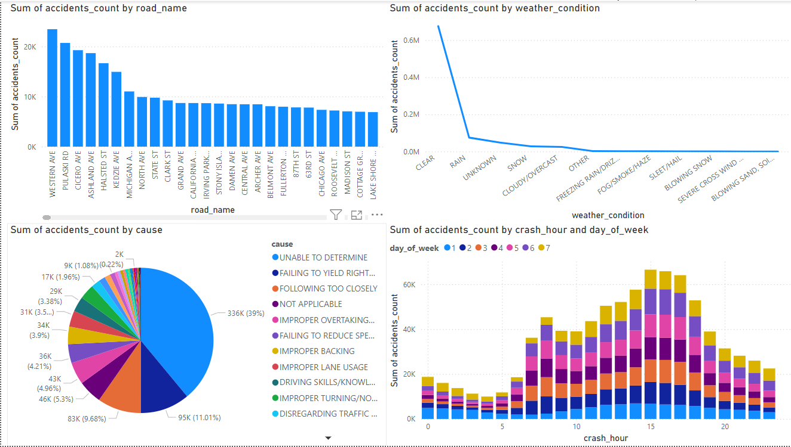
3.4. Data Visualization of Query Results
Unit 3. Results
UNIT
03
Data visualization is a powerful tool for communicating insights from the data. This section describes the visualizations created from the query results and their significance.

Slide 28
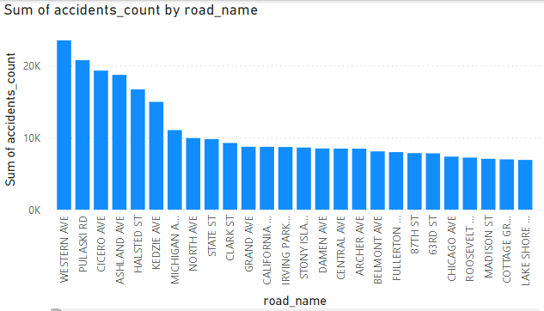
3.4. Data Visualization of Query Results
Unit 3. Results
UNIT
03
Visualization 1: Accident Frequency by Location
Description: A bar chart displaying the frequency of accidents across different locations, highlighting the most dangerous roads.
Significance: This visualization helps quickly identify which locations require the most attention for traffic safety improvements.

Slide 29
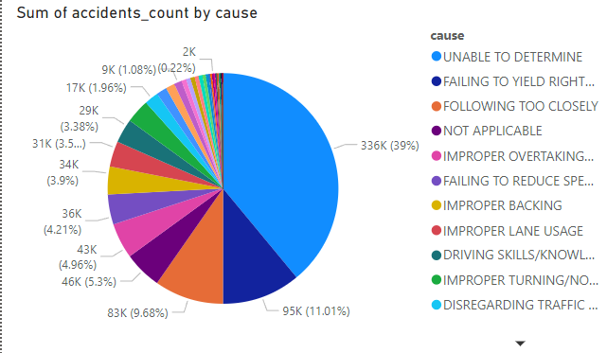
3.4. Data Visualization of Query Results
Unit 3. Results
UNIT
03
Visualization 2: Statistics on causes of accidents
Description: A pie chart showing the distribution of accidents by severity level, providing an overview of how severe most accidents tend to be.
Significance: Understanding the severity distribution helps in prioritizing response strategies, particularly for high-severity areas.

Slide 30
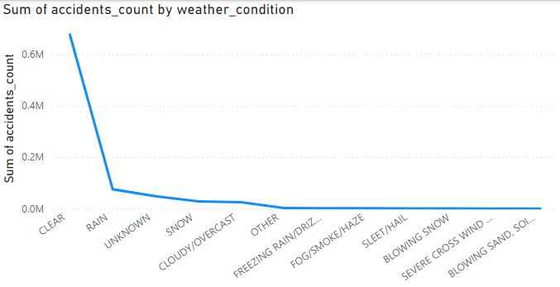
3.4. Data Visualization of Query Results
Unit 3. Results
UNIT
03
Visualization 3: Weather Impact on Accidents
Description: A line graph plotting the number of accidents against different weather conditions, illustrating the correlation between weather and accident frequency.
Significance: This visualization underscores the need for weather-specific safety
measures, such as advisories or road closures during hazardous conditions.

Slide 31
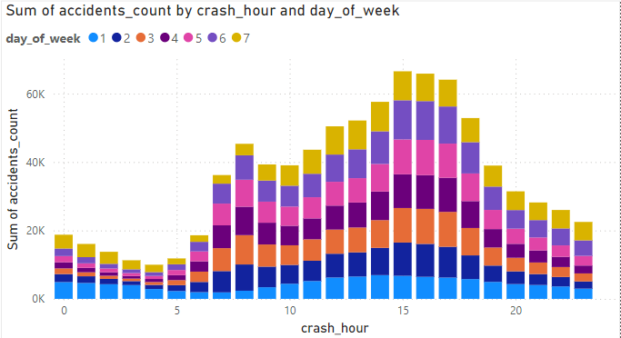
3.4. Data Visualization of Query Results
Unit 3. Results
UNIT
03
Visualization 4: Time-of-Day Analysis
Description: A heat map showing accident occurrences at different times of the day, with emphasis on rush hours.
Significance: The heat map reveals the times of day when accidents are most frequent, guiding the implementation of targeted interventions such as increased patrols or traffic calming measures during high-risk periods.

Slide 32
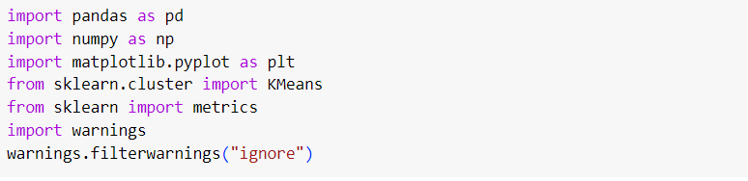
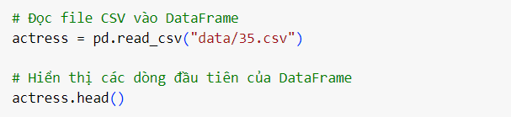
3.5. AI & ML
Unit 3. Results
UNIT
03
3.5.1. AI
Declare the library to use:
Get input data

Slide 33
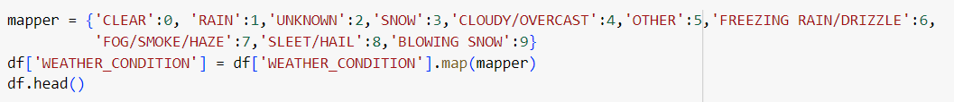
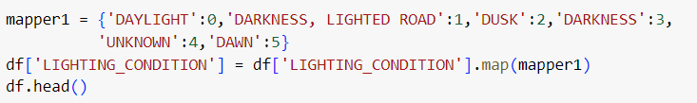
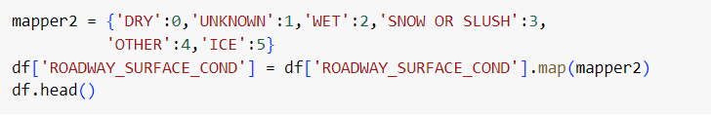
3.5. AI & ML
Unit 3. Results
UNIT
03
3.5.1. AI
Get Data to create model:
Converts string data to numbers

Slide 34
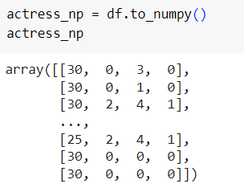
3.5. AI & ML
Unit 3. Results
UNIT
03
3.5.1. AI
Convert data to a two-dimensional array as input to the KMeans algorithm

Slide 35
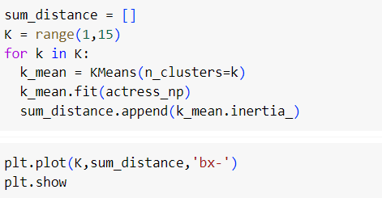
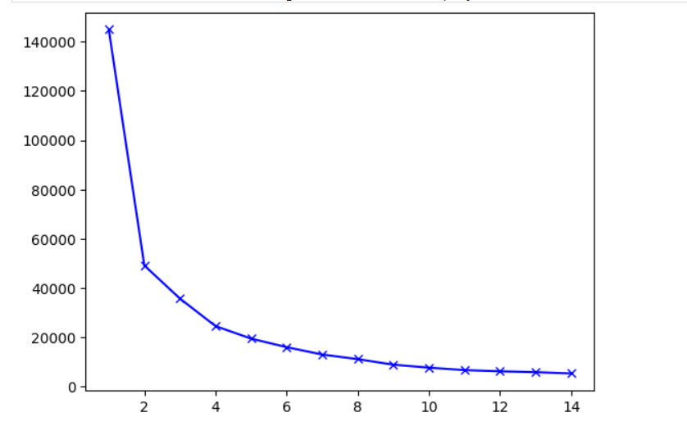
3.5. AI & ML
Unit 3. Results
UNIT
03
3.5.1. AI
Use the elbow algorithm to find the clustering number

Slide 36
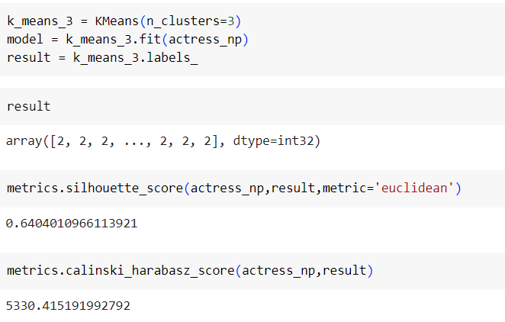
3.5. AI & ML
Unit 3. Results
UNIT
03
3.5.1. AI
Use two functions: silhouette_score and calinski_harabasz_score to evaluate the algorithm score

Slide 37
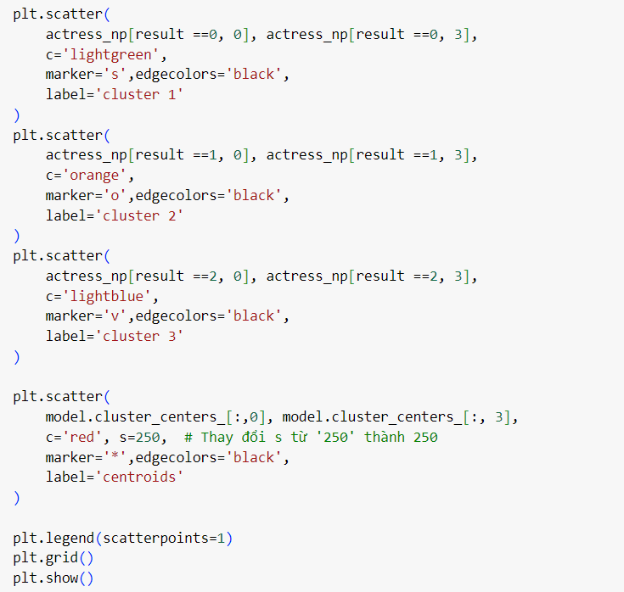
3.5. AI & ML
Unit 3. Results
UNIT
03
3.5.1. AI
Draw a chart after using the algorithm: the chart shows the number of clusters, distinguishing between clusters by color. The center point of the cluster is the star shape

Slide 38
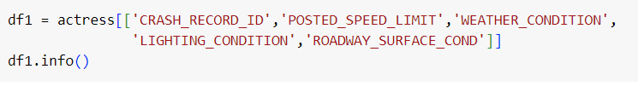

3.5. AI & ML
Unit 3. Results
UNIT
03
3.5.1. AI
Create two tables from DataLake data: one table is the input of the model, one table is the desired output of the model
Combine two tables and assign clusters

Slide 39
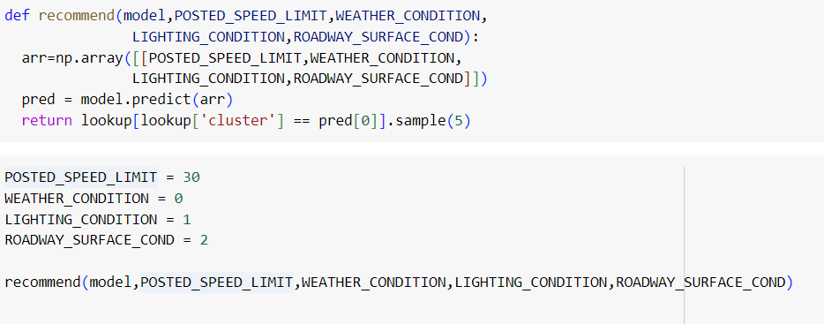
3.5. AI & ML
Unit 3. Results
UNIT
03
3.5.1. AI
Write the functions of the AI ​​model and conduct testing

Slide 40
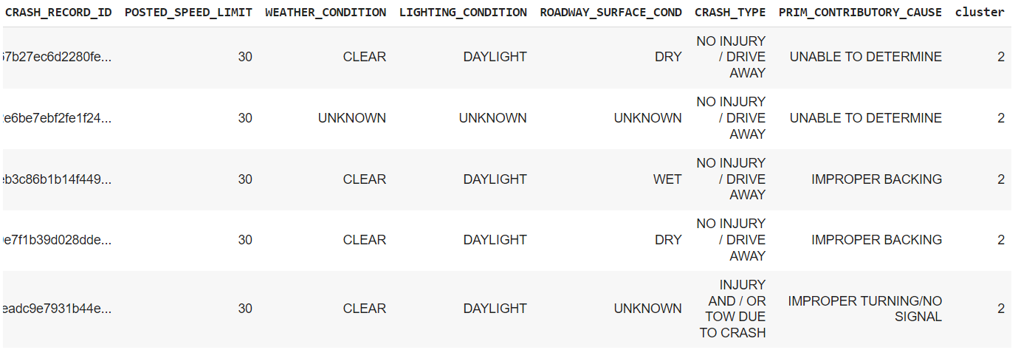
3.5. AI & ML
Unit 3. Results
UNIT
03
3.5.1. AI
The output gives us information about the suggestion to the user

Slide 41
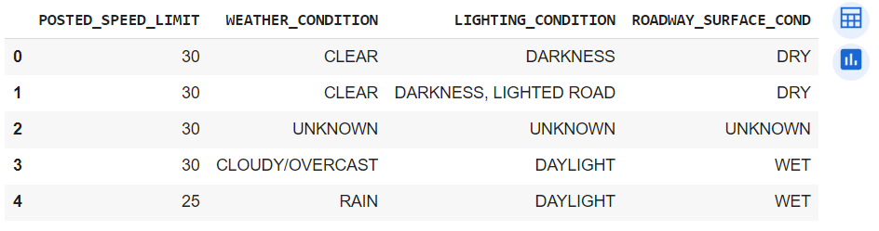
3.5. AI & ML
Unit 3. Results
UNIT
03
3.5.2. Machine Learning

Slide 42
UNIT
03
Unit 4. Impact of the project

Slide 43
4.1. Accomplishment & Benefit
Unit 4. Impact of the project
UNIT
02
The analysis of traffic crash data on American roadways has yielded several significant accomplishments and benefits. These outcomes not only provide valuable insights into
traffic safety but also offer practical solutions for reducing accident rates and improving
road safety.
Key Accomplishments:
Identification of High-Risk Areas
Understanding of Accident Causes
Development of Predictive Models
Enhanced Data-Driven Decision Making
Overall Benefits:
Improved Road Safety
Informed Policy Recommendations
Public Awareness
Efficient Resource Allocation

Slide 44
4.2. Future Improvement
Unit 4. Impact of the project
UNIT
02
While the current project has achieved significant milestones, there are several areas for future improvement that can enhance the impact and effectiveness of traffic safety
analyses.Potential Future Improvements
Integration of Real-Time Data:
Incorporation of Additional Data Sources:
Refinement of Predictive Models
Expansion to Other Regions
Enhanced Visualization Tools

Slide 45
4.2. Future Improvement
Unit 4. Impact of the project
UNIT
02
In Summary:
The projected impact of this project demonstrates the potential for significant
improvements in road safety through data-driven insights and targeted interventions.
Future enhancements and expansions will further strengthen the ability to address traffic safety challenges and contribute to safer roadways for all.

